Slide 1

Chapter 1
Overview of Security Principles
Amir H. Razavi

Slide 2
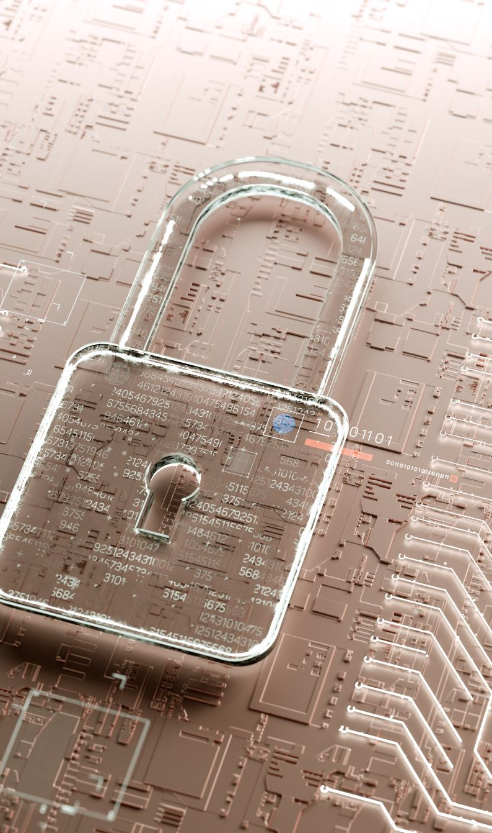
Overview
Computer Security is the practice of safeguarding data, hardware, software, communication networks, and associated devices from unauthorized access or control by individuals or entities that are not the rightful owners or authorized agents. The goal is to prevent intentional misuse and ensure the integrity and confidentiality of the system's assets.
Additionally, mechanisms designed to protect systems from unintentional damage, human error, or system failures, such as those that enhance reliability and redundancy, are also important for maintaining overall security. However, these aspects, while sometimes essential, are not the primary focus when discussing computer security in terms of preventing malicious activities.

Slide 3
Computer Security Concepts
Before the widespread use of data processing equipment, the security of information valuable to an organization was provided primarily by physical and administrative means
With the introduction of the computer, the need for automated tools for protecting files and other information stored on the computer became evident
Another major change that affected security is the introduction of distributed systems and the use of networks and communications facilities for carrying data between terminal user and computer and between computer and computer
Computer security
The generic name for the collection of tools designed to protect data and to thwart hackers
internet security (lower case “i” refers to any interconnected collection of network)
Consists of measures to deter, prevent, detect, and correct security violations that involve the transmission of information
Notes:
The way organizations handle information security has changed a lot over the years. Before computers became common, securing sensitive information mostly meant physical measures, like using locked filing cabinets, or administrative steps, such as screening employees before hiring.
Once computers came into the picture, there was a clear need for digital tools to protect files, especially on systems that are shared or accessible to the public. These tools, known as computer security, are used to keep data safe from unauthorized access.
Another big shift happened when organizations started using distributed systems and networks, which led to the need for network security to keep data safe while it's being transmitted. But the term "network security" doesn't quite cover it, since most systems today are connected through various networks, making internet security a better description.
There’s often a mix of these security types, since threats like viruses can enter a system in different ways—either through physical devices or over the internet. Once inside, both computer and internet security measures are needed to find and fix the problem.
Cyber security, is focusing on how to prevent, detect, and fix security issues mostly related to data transmission.

Slide 4
Computer Security Definition
The NIST Computer Security Handbook defines the term computer security as:
“The protection afforded to an automated information system in order to attain the applicable objectives of preserving the integrity, availability, and confidentiality of information system resources (includes hardware, software, firmware, information/data, and telecommunications)”
Notes:
The NIST Computer Security Handbook [NIST95] defines the term computer security
as follows:
Computer Security: The protection afforded to an automated information system
in order to attain the applicable objectives of preserving the integrity, availability,
and confidentiality of information system resources (includes hardware, software,
firmware, information/data, and telecommunications).

Slide 5
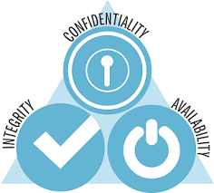
Computer Security objectives
Confidentiality
Data confidentiality
Assures that private or confidential information is not made available or disclosed to unauthorized individuals
Privacy
Assures individual's control or influence on what information related to them may be collected and stored and by whom and to whom that information may be disclosed
Availability
Assures that systems work promptly, and service is not denied to authorized users
Assures that a system performs its intended function in an unimpaired manner, free from deliberate or inadvertent unauthorized manipulation of the system
System integrity
Assures that information and programs are changed only in a specified and authorized manner
Data integrity
Integrity
(CIA)
Notes:
This definition introduces three key objectives that are at the heart of computer
security:
• Confidentiality: This term covers two related concepts:
Data confidentiality: Assures that private or confidential information is
not made available or disclosed to unauthorized individuals.
Privacy: Assures that individuals control or influence what information
related to them may be collected and stored and by whom and to whom
that information may be disclosed.
•Integrity: This term covers two related concepts:
Data integrity: Assures that information and programs are changed only in
a specified and authorized manner.
System integrity: Assures that a system performs its intended function in
an unimpaired manner, free from deliberate or inadvertent unauthorized
manipulation of the system.
• Availability: Assures that systems work promptly, and service is not denied to
authorized users.
Discussion Question: What are the most critical aspects of the CIA Triad in your opinion, and why?

Slide 6
Security Components
Confidentiality:
Who determines the access authorization for users?
What is the limit of any access?
What are the user’s obligation?
Integrity:
What is the exact meaning of integrity?
Precise, accurate, unmodified, consistent, …
Authorized actions
Separation and protection of resources
Error detection and correction
Availability:
To both data and services (processing)
Timely response to requests
Fair resource allocation
Fault tolerance
Easy use of services
Concurrency issues
Simultaneous access
Deadlock management
Exclusive access

Slide 7
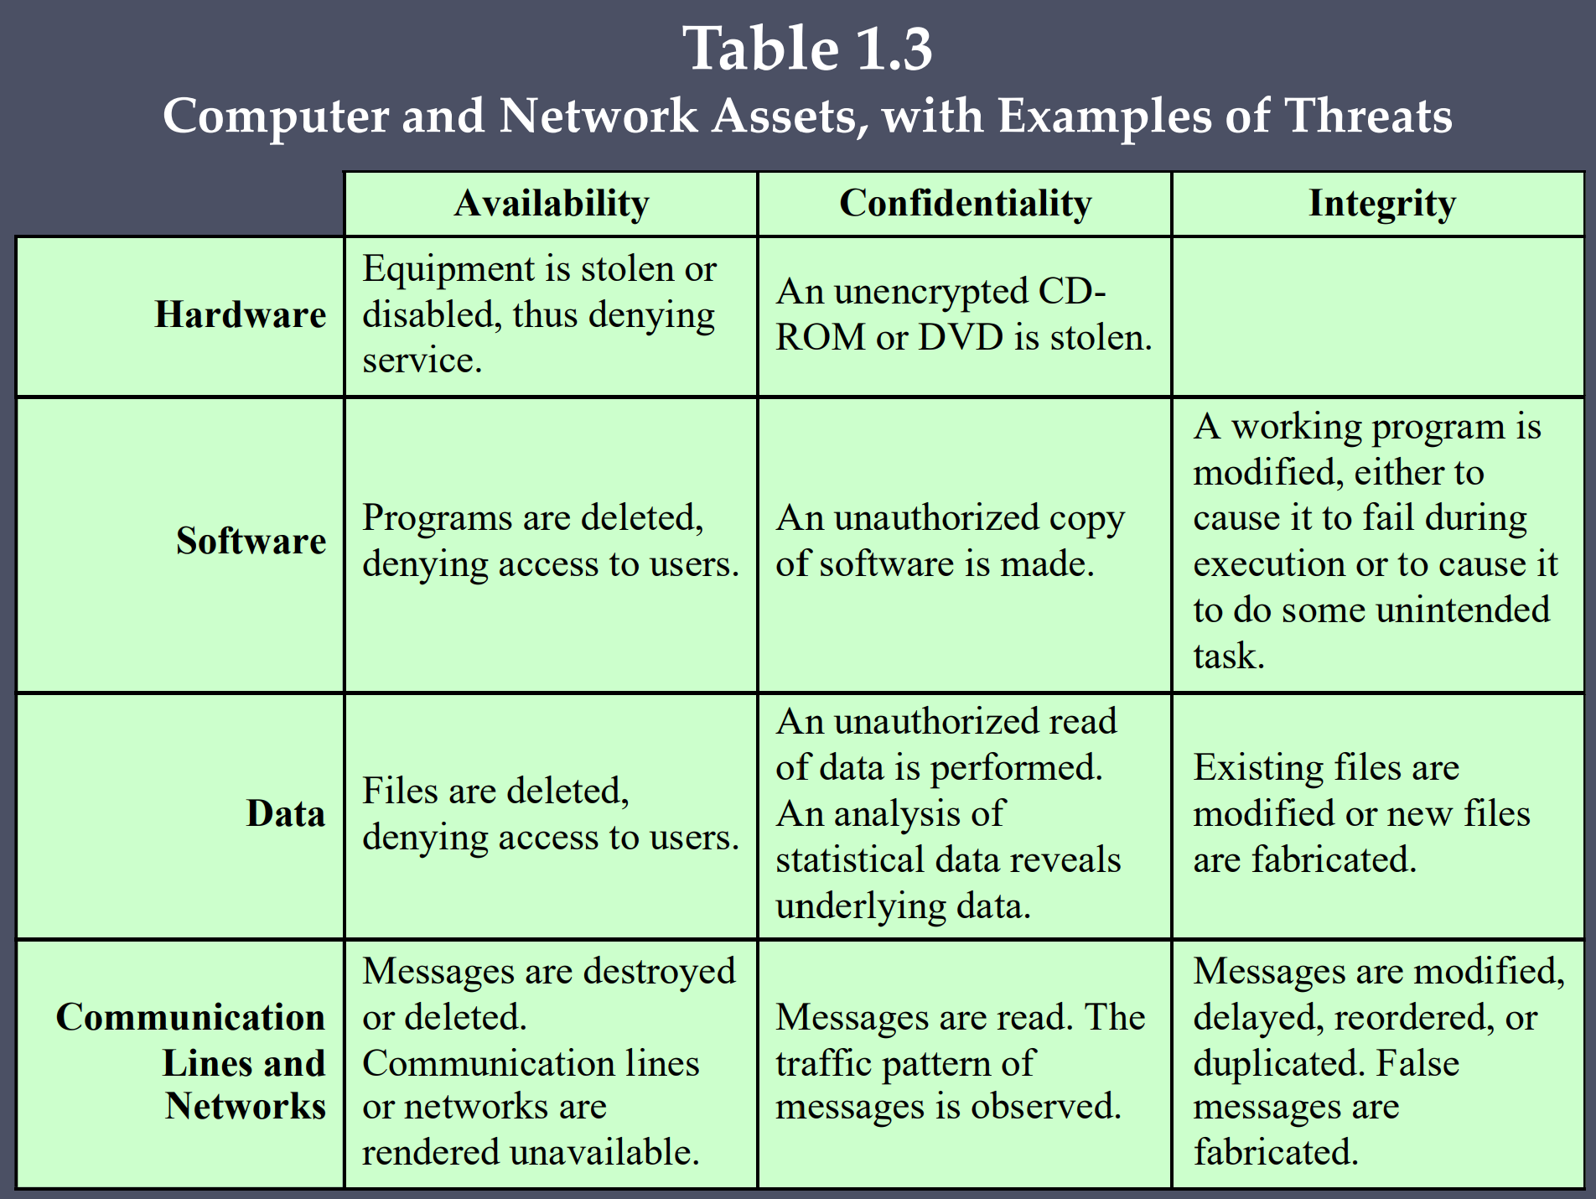


Slide 8
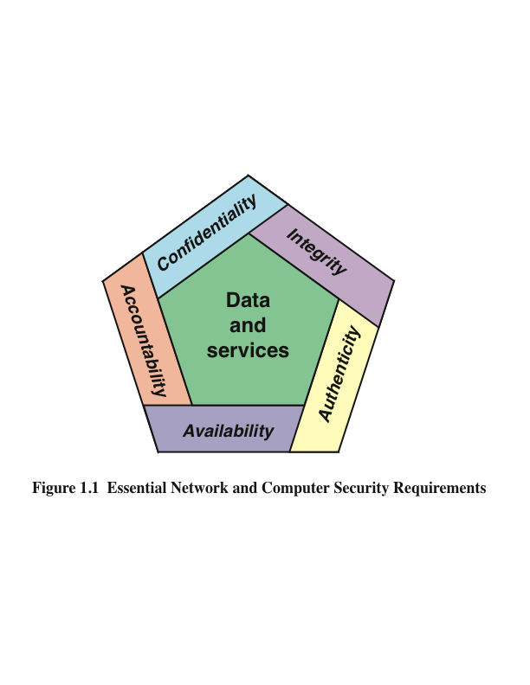
IS CIA enough?
Notes:
These three concepts form what is often referred to as the CIA triad . The
three concepts embody the fundamental security objectives for both data and for
information and computing services. For example, the NIST Standards for Security
Categorization of Federal Information and Information Systems (FIPS 199) lists
confidentiality, integrity, and availability as the three security objectives for information
and for information systems. FIPS 199 provides a useful characterization
of these three objectives in terms of requirements and the definition of a loss of
security in each category.
• Confidentiality: Preserving authorized restrictions on information access
and disclosure, including means for protecting personal privacy and proprietary
information. A loss of confidentiality is the unauthorized disclosure of
information.
• Integrity: Guarding against improper information modification or destruction,
including ensuring information nonrepudiation and authenticity. A loss of
integrity is the unauthorized modification or destruction of information.
• Availability: Ensuring timely and reliable access to and use of information.
A loss of availability is the disruption of access to or use of information or an
information system.

Slide 9

Possible additional concepts:
Authenticity
Verifying that users are who they say they are and that each input arriving at the system came from a trusted source
Accountability
The security goal that generates the requirement for actions of an entity to be traced uniquely to that entity
Notes:
Although the use of the CIA triad to define security objectives is well established,
some in the security field feel that additional concepts are needed to present
a complete picture. Two of the most commonly mentioned are as follows:
• Authenticity: The property of being genuine and being able to be verified and
trusted; confidence in the validity of a transmission, a message, or message
originator. This means verifying that users are who they say they are and that
each input arriving at the system came from a trusted source.
• Accountability: The security goal that generates the requirement for actions
of an entity to be traced uniquely to that entity. This supports nonrepudiation,
deterrence, fault isolation, intrusion detection and prevention, and after action
recovery and legal action. Because truly secure systems are not yet an
achievable goal, we must be able to trace a security breach to a responsible
party. Systems must keep records of their activities to permit later forensic
analysis to trace security breaches or to aid in transaction disputes.

Slide 10
Examples of Security Requirements and Impact Levels
Confidentiality
Student grade information is an asset whose confidentiality is considered to be highly important by students
Regulated by the Family Educational Rights and Privacy Act (FERPA)
Integrity
Patient information stored in a database – inaccurate information could result in serious harm or death to a patient and expose the hospital to massive liability
A Web site that offers a forum to registered users to discuss some specific topic would be assigned a moderate level of integrity
An example of a low-integrity requirement is an anonymous online poll
Availability
The more critical a component or service (such as a web server for a service provider), the higher the level of availability required
A moderate availability requirement is a public Web site for a university
An online telephone directory lookup application would be classified as a low-availability requirement
Notes:
Confidentiality
Student grade information is an asset whose confidentiality is
considered to be highly important by students. In the United States, the release of such information is regulated by the Family Educational Rights and Privacy Act (FERPA). Grade information should only be available to students, their parents, and employees that require the information to do their job. Student enrollment information may have a moderate confidentiality rating. While still covered by FERPA, this information is seen by more people on a daily basis, is less likely to be targeted than grade information, and results in less damage if disclosed. Directory information (such as lists of students, faculty, or departmental lists) may be assigned a low confidentiality rating or indeed no rating. This information is typically freely available to the public and published on a school’s Web site.
Integrity
Several aspects of integrity are illustrated by the example of a hospital
patient’s allergy information stored in a database. The doctor should be able to
trust that the information is correct and current. Now suppose that an employee (e.g., a nurse) who is authorized to view and update this information deliberately falsifies the data to cause harm to the hospital. The database needs to be restored to a trusted basis quickly, and it should be possible to trace the error back to the person responsible. Patient allergy information is an example of an asset with a high requirement for integrity. Inaccurate information could result in serious harm or death to a patient and expose the hospital to massive liability.
An example of an asset that may be assigned a moderate level of integrity
requirement is a Web site that offers a forum to registered users to discuss some specific topic. Either a registered user or a hacker could falsify some entries or deface the Web site. If the forum exists only for the enjoyment of the users, brings in little or no advertising revenue, and is not used for something important such as research, then potential damage is not severe. The Web master may experience some data, financial, and time loss.
An example of a low-integrity requirement is an anonymous online poll. Many
Web sites, such as news organizations, offer these polls to their users with very few safeguards. However, the inaccuracy and unscientific nature of such polls are well understood.
Availability
The more critical a component or service, the higher is the level of
availability required. Consider a system that provides authentication services for critical systems, applications, and devices. An interruption of service results in the inability for customers to access computing resources and for the staff to access the resources they need to perform critical tasks. The loss of the service translates into a large financial loss due to lost employee productivity and potential customer loss.
An example of an asset that typically would be rated as having a moderate
availability requirement is a public Web site for a university; the Web site provides information for current and prospective students and donors. Such a site is not a critical component of the university’s information system, but its unavailability will cause some embarrassment.
An online telephone directory lookup application would be classified as a low availability requirement. Although the temporary loss of the application may be
an annoyance, there are other ways to access the information, such as a hardcopy directory or the operator.

Slide 11
Threats
While computer security is concerned with safeguarding assets, which include information, software, hardware, and the services provided by computing and communication systems.
A threat refers to any situation or entity that could potentially harm these assets or lead to security breaches, such as unauthorized access, data theft, or system damage.

Slide 12
Risks
Risk refers to the potential loss that may occur due to future harmful events, considering a specific set of assets and a defined time period.
It depends on several factors, including the threat agents (individuals or entities capable of causing harm), the likelihood of an attack (and its success, which is contingent upon existing vulnerabilities), and the potential losses that would result if the threat were successful. The concept of risk helps in assessing how to prioritize security measures based on the probability and impact of different threats.

Slide 13
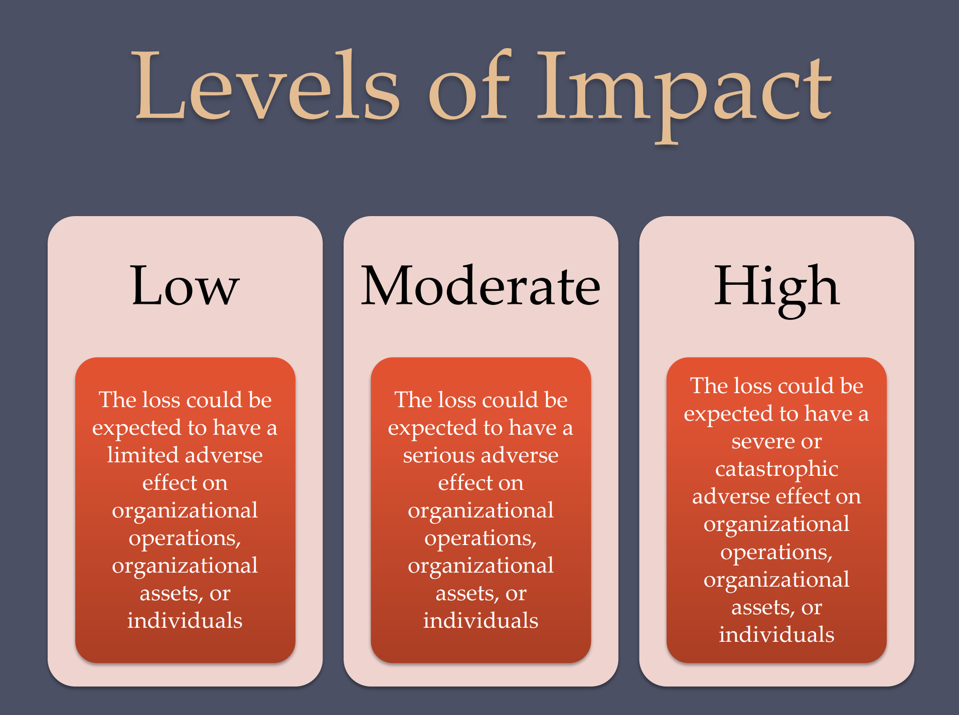

Slide 14
Risks assessment
Quantitative risk assessment involves calculating numerical estimates of risk by assigning specific values to factors like the probability of an attack and the potential damage. However, in practice, it is often difficult to achieve precise estimates due to uncertainties and lack of complete data.
On the other hand, qualitative risk assessment provides a more practical approach. It focuses on comparing and ranking risks relative to each other based on their severity and likelihood, without requiring exact numerical values. This method helps organizations prioritize threats and allocate resources more effectively.

Slide 15
Security Policies
A security policy defines the intended design and behavior of a system's rules and practices, outlining what is and is not permitted within the system. The policy typically includes:
The assets that need protection.
The specific users who are authorized to access these assets.
The methods or means of access that are allowed.
The security services that should be in place to safeguard the system.
The controls that must be implemented to ensure these rules are enforced.
Notes:
This policy serves as a framework to ensure that the system operates within the defined security boundaries and that unauthorized actions are prevented.

Slide 16
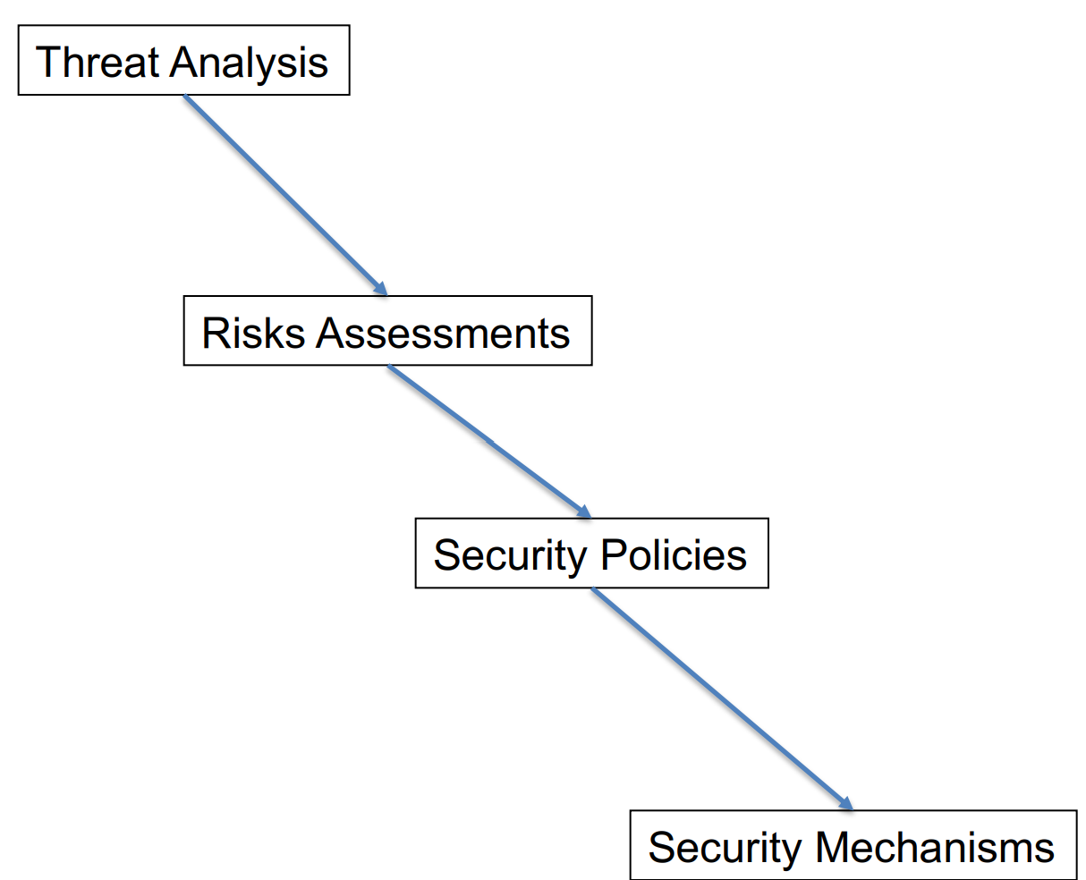
Security Mechanisms
Security defences and mechanisms are tools used to enforce security policies and services. They ensure the protection of assets and prevent unauthorized access by implementing measures like firewalls, encryption, and access controls. These defences support the overall security framework set by the system’s policies.

Slide 17
OSI Security Architecture
Security attack
Any action that compromises the security of information owned by an organization
Security Solutions
Security service
A processing or communication service that enhances the security of the data processing systems and the information transfers of an organization. Intended to counter security attacks, and they make use of one or more security mechanisms to provide the service
Security mechanism
A process (or a device incorporating such a process) that is designed to detect, prevent, or recover from a security attack
Notes:
To effectively assess an organization’s security needs and select appropriate security products and policies, a manager must have a structured method for identifying security requirements and evaluating potential solutions. This becomes even more challenging in environments with complex local and wide-area networks, as opposed to centralized data processing systems, where the scale and diversity of threats increase significantly.

Slide 18
Passive Attacks
Are eavesdropping on, or monitoring of, transmissions
Goal of the opponent is to obtain information that is being transmitted
Two types of passive attacks are:
The release of message contents
Traffic analysis
Eavesdropping
IP Spoofing
Packet Sniffing
Scanning
Tapping
Traffic Analysis
Notes:
The goal of the opponent is to obtain information that is being
transmitted. Two types of passive attacks are the release of message contents and
traffic analysis.
The release of message contents is easily understood. A telephone conversation,
an electronic mail message, and a transferred file may contain sensitive or
confidential information. We would like to prevent an opponent from learning the
contents of these transmissions.
A second type of passive attack, traffic analysis , is subtler. Suppose that we
had a way of masking the contents of messages or other information traffic so that
opponents, even if they captured the message, could not extract the information
from the message. The common technique for masking contents is encryption. If we
had encryption protection in place, an opponent might still be able to observe the
pattern of these messages. The opponent could determine the location and identity
of communicating hosts and could observe the frequency and length of messages
being exchanged. This information might be useful in guessing the nature of the
communication that was taking place.
Passive attacks are very difficult to detect, because they do not involve any
alteration of the data. Typically, the message traffic is sent and received in an apparently
normal fashion, and neither the sender nor receiver is aware that a third party
has read the messages or observed the traffic pattern. However, it is feasible to prevent
the success of these attacks, usually by means of encryption. Thus, the emphasis
in dealing with passive attacks is on prevention rather than detection.

Slide 19
Active Attacks
Masquerade
Takes place when one entity pretends to be a different entity
Usually includes one of the other forms of active attack
Replay
Involves the passive capture of a data unit and its subsequent retransmission to produce an unauthorized effect
Modification of messages
Some portion of a legitimate message is altered, or messages are delayed or reordered to produce an unauthorized effect
Denial of service
Prevents or inhibits the normal use or management of communications facilities
Involve some modification of the data stream or the creation of a false stream
Difficult to prevent because of the wide variety of potential physical, software, and network vulnerabilities
Notes:
Active attacks involve interference with the flow of data and can be broken down into four types: masquerade, replay, message modification, and denial of service.
Masquerade occurs when an entity falsely assumes the identity of another. It often includes other forms of attack. For instance, an attacker can intercept an authentication sequence and replay it to gain unauthorized access.
Replay involves capturing a data transmission and resending it to produce unauthorized effects.
Modification of messages refers to altering legitimate messages or reordering them to produce unintended results, such as changing permissions in a file access request.
Denial of service (DoS) aims to disrupt normal communications by either overloading the network with traffic or preventing access to certain services.
While passive attacks are hard to detect but preventable, active attacks are difficult to entirely prevent due to the wide range of vulnerabilities they exploit. The focus for active attacks is on detection and recovery, which can also serve as a deterrent against future attacks.

Slide 20
Chapter 2
Threat Models and Risk Assessment
Amir H. Razavi

Slide 21
Types of Threats in Secure Systems
Internal Threats
Insider Threats:
Malicious actions by authorized individuals (employees, contractors)
Examples: Data theft, sabotage, fraud
Accidental Errors: Human mistakes leading to security breaches
Examples: Misconfigurations, weak passwords
External Threats
Hackers: Individuals or groups with malicious intent
Examples: Malware, phishing, DDoS attacks
Nation-State Actors: Governments targeting critical infrastructure
Examples: Espionage, cyber warfare
Organized Crime: Criminal groups seeking financial gain
Examples: Ransomware, identity theft
Notes:
To design secure systems, it’s essential to understand the types of threats that systems may face and how to assess the associated risks.

Slide 22
Types of Threats in Secure Systems- Count.
Natural Threats
Disasters: Natural events that can disrupt operations
Examples: Fires, floods, earthquakes
Technological Threats
Software Vulnerabilities: Weaknesses in software
Examples: Buffer overflows, SQL injection
Hardware Failures: Malfunctions of physical components
Examples: Disk drive failures, power outages
Emerging Threats
Internet of Things (IoT) Security: Vulnerabilities in connected devices
Cloud Security: Threats specific to cloud-based environments
Supply Chain Attacks: Targeting third-party vendors

Slide 23

Threat Modelling: A Systematic Approach to Security
Threat modelling is a proactive process to identify and mitigate potential security risks.
The Threat Modeling Process:
Identify Assets: Determine what you're protecting (data, systems, etc.).
Identify Threats: Use techniques like STRIDE or DREAD to identify potential threats.
Analyse Vulnerabilities: Assess how threats could exploit vulnerabilities in your system.
Prioritize Risks: Evaluate the likelihood and impact of each threat.
Develop Mitigation Strategies: Create plans to address identified risks.
Notes:
Threat Modeling: A process used to identify potential threats to a system, understand how they might exploit vulnerabilities, and determine the impact of such threats.

Slide 24
Threat Modeling in Practice
Assets: Customer data, payment information, website functionality
Threats: Phishing, SQL injection, DDoS attacks
Vulnerabilities: Weak passwords, unpatched software
Mitigation Strategies: Input validation, encryption, firewalls
Benefits of Threat Modelling
Proactive Risk Management: Identify threats before they can be exploited.
Improved Security Posture: Develop targeted security measures.
Compliance: Demonstrate adherence to security standards.
Enhanced Decision-Making: Support informed security investments.
Notes:
Threat modelling is an essential part of cybersecurity and system design, helping organizations identify, understand, and mitigate potential security threats early in the development process.

Slide 25
Threat Modeling Techniques
STRIDE:
Spoofing: False identity or impersonation
Tampering: Unauthorized modification of data
Repudiation: Denying involvement in an action
Information Disclosure: Unauthorized access to sensitive information
Denial of Service: Preventing legitimate use of a system
Elevation of Privilege: Gaining unauthorized access to resources

Slide 26
Threat Modeling Techniques
DREAD:
Damage: Potential harm caused by the threat
Reproducibility: How easily can the threat be repeated
Exploitability: The ease of exploiting the vulnerability
Affected Users: The number of people impacted by the threat
Discoverability: How likely is the threat to be discovered

Slide 27
Analyze a System from a Security Perspective
Vulnerabilities
Weakness in the security system
Vulnerable to unauthorized data manipulation
Threats
A set of circumstances that has the potential to cause loss or harm
Illicit copying of program or data files
Attacks
Harm or loss committed by a person or system who exploit a vulnerability
DOS attack
Notes:
The goal of Computer Security is to protect valuable assets.
We should use a framework to describe how assets can be harmed, and how to counter or mitigate that harm.

Slide 28
Risk Assessment: Evaluating and Prioritizing Threats
Risk assessment is essential for making informed security decisions.
The Risk Assessment Process
Identify Assets: Determine what you're protecting (data, systems, etc.).
Identify Threats: Use techniques like STRIDE or DREAD to identify potential threats.
Analyse Vulnerabilities: Assess how threats could exploit vulnerabilities in your system.
Calculate Risk: Determine the likelihood and impact of each threat.
Prioritize Risks: Rank threats based on their risk level.
Notes:
Risk Assessment: Involves evaluating the likelihood and impact of potential threats. The goal is to prioritize risks so that resources can be allocated effectively to mitigate the most significant threats.

Slide 29
Risk Assessment: Evaluating and Prioritizing Threats
Likelihood and Impact:
Likelihood: The probability that a threat will occur.
Impact: The severity of the consequences if the threat materializes.
Risk Level: The combination of likelihood and impact.
Risk Assessment Techniques:
Qualitative Assessment: Using subjective judgments to assess risk.
Quantitative Assessment: Using numerical values to measure risk.
Risk Matrix: A visual tool for representing risk levels.

Slide 30
Risk Assessment: Evaluating and Prioritizing Threats
Risk Mitigation Strategies:
Avoidance: Eliminate the threat or vulnerability.
Reduction: Reduce the likelihood or impact of the threat.
Transfer: Shift the risk to a third party (e.g., insurance).
Acceptance: Acknowledge the risk and decide not to take action.
Benefits of Risk Assessment:
Informed Decision-Making: Allocate resources effectively.
Prioritized Security Efforts: Focus on the most critical threats.
Compliance: Demonstrate adherence to security standards.
Risk Management: Reduce the overall risk to the organization.

Slide 31
Mitigating Risks: Implementing Security Controls
Controls
The ways to address committed, or possible attacks
The ways to protect systems
Could be actions, devices, procedures, or techniques that remove or reduce vulnerabilities
A Threat is blocked by Control of a Vulnerability
Notes:
Mitigation Strategies: After assessing risks, security measures are put in place to reduce the likelihood or impact of those risks. These can include technical controls (e.g., firewalls, encryption), administrative controls (e.g., policies, procedures), and physical controls (e.g., locks, surveillance).

Slide 32
Mitigating Risks: Implementing Security Controls
Effective mitigation strategies are essential for reducing the impact of identified threats.
Types of Security Controls:
Technical Controls: Utilize technology to protect systems.
Examples: Firewalls, encryption, intrusion detection systems
Administrative Controls: Policies, procedures, and guidelines.
Examples: Access control policies, security awareness training
Physical Controls: Protect hardware and facilities.
Examples: Locks, surveillance, environmental controls
Mitigation Strategies in Practice:
Threat: SQL injection
Mitigation: Input validation, parameterized queries
Threat: Phishing
Mitigation: Strong password policies, multi-factor authentication
Threat: Denial-of-service (DoS) attacks
Mitigation: DDoS protection, rate limiting

Slide 33
Key Concepts and Terminology
Vulnerability: A weakness in a system that can be exploited by a threat actor to perform unauthorized actions.
Exploit: A method or tool used to take advantage of a vulnerability.
Attack Surface: The total sum of the different points where an unauthorized user can try to enter data to or extract data from an environment.
Defense in Depth: A security strategy that employs multiple layers of defense to protect a system.

Slide 34
Types of Vulnerabilities:
Technical Vulnerabilities:
Software vulnerabilities: Common types include buffer overflows, SQL injection, cross-site scripting (XSS), and remote code execution.
Hardware vulnerabilities: Weaknesses in physical devices or their configurations.
Configuration vulnerabilities: Improper settings or misconfigurations that can expose systems to risks.
Operational Vulnerabilities: Arising from poor security management, such as improper credential management, lack of patches, or weak encryption protocols.
Human Vulnerabilities: Resulting from social engineering, such as phishing or insider threats.
Notes:
A vulnerability is a weakness or flaw in a system, application, or network that can be exploited by a malicious actor to gain unauthorized access or control. These weaknesses can be present in software code, hardware configurations, or human processes.

Slide 35
Vulnerability Lifecycle
Discovery: Vulnerabilities can be discovered by researchers (ethical hackers), threat actors, or through routine testing.
Disclosure: Once a vulnerability is found, it is typically reported to the responsible vendor or organization.
Patching: A fix or patch is developed and applied to mitigate the vulnerability. In cases where no fix exists, temporary measures like firewalls or network segmentation may be employed to minimize risk.
Code Reviews: Regular analysis of software code to identify and fix vulnerabilities before deployment.
Security Testing: Conducting penetration tests and vulnerability assessments to identify weaknesses.

Slide 36
Exploit: Leveraging Vulnerabilities for Attacks
Zero-Day Exploits: These are exploits that take advantage of vulnerabilities unknown to the software vendor, meaning no patch or fix is available at the time of the attack. Zero-day attacks are highly dangerous as they leave systems unprotected .
Remote Exploits: These are designed to attack vulnerabilities over a network without physical access to the system. For example, an attacker can use a buffer overflow vulnerability in a server to inject malicious code remotely.
Local Exploits: These require the attacker to have some form of access to the system. Once they gain access, they can use exploits like privilege escalation to gain control over higher-level functions of the system .
Notes:
Definition: An exploit refers to a method, tool, or script used to take advantage of a vulnerability in a system. Exploits enable threat actors to gain control of a system, manipulate it, or cause unintended behavior.

Slide 37
Mitigation Strategies
Intrusion Detection and Prevention Systems (IDPS): Systems designed to detect malicious traffic associated with exploits and prevent them from compromising systems.
Zero-Day Protection: Using machine learning and anomaly detection to identify potential zero-day exploits.
Regular Updates and Patch Management: Patching known vulnerabilities to prevent exploits from being effective.

Slide 38
Attack Surface: The Total Points of Entry for Potential Attacks
Network Attack Surface: Includes all the vulnerable points where attackers can interact with the network, such as open ports, exposed services, and insecure APIs.
Software Attack Surface: This includes the code vulnerabilities in the software, including libraries and third-party dependencies that may harbour security flaws.
User behaviour: User actions and practices can create additional attack surfaces.
Third-party components: Dependencies on external software or services can introduce vulnerabilities.
Physical Attack Surface: Refers to the physical locations where an attacker can gain access to infrastructure, including data centres, servers, and workstations.
Notes:
Definition: The attack surface refers to the total sum of all possible entry points or vectors through which an attacker can try to gain access to or extract data from an environment. Reducing the attack surface is a crucial strategy for enhancing security.

Slide 39
Mitigation Strategies
Reduce Unnecessary Features: Disabling or removing features, services, and code that are not necessary for the system's functionality.
Network Segmentation: Isolating sensitive parts of the network to limit the scope of an attack.
Minimizing Privileges: Limiting user and process privileges to minimize the potential for exploitation.

Slide 40
Defence in Depth: Layered Security
Layered security: Employing various security controls at different levels of the system:
Physical Security: Protecting hardware through locks, surveillance, and restricted access.
Network Security: Firewalls, intrusion detection/prevention systems (IDS/IPS), and network segmentation.
Endpoint Security: Ensuring that devices such as laptops and mobile phones are protected with antivirus software and encryption.
Application Security: Implementing security best practices in coding, like input validation and using secure libraries.
User Awareness and Policies: Educating users about security risks, enforcing strong password policies, and applying least-privilege principles to minimize access to sensitive systems .
Notes:
Definition: Defence in Depth is a security strategy that employs multiple layers of defense to protect a system. It is based on the assumption that no single security measure is foolproof, and therefore, combining several defenses increases overall security.

Slide 41
Defence in Depth lies in using a mix of preventive, detective, and corrective measures Plus…
Preventive: Firewalls, antivirus software, access controls.
Detective: Intrusion detection systems, log monitoring, audits.
Corrective: Incident response plans, backups, disaster recovery mechanisms.
Layered Security: Implementing multiple layers of defence at the perimeter, network, and application levels.
Continuous Monitoring: Using SIEM (Security Information and Event Management) tools to continuously monitor and detect anomalous activity.
Segmentation: Dividing the system into smaller, isolated segments to limit the spread of attacks.
Incident Response Plans: Preparing for potential breaches with structured incident response protocols.

